Slide 1
Using NLP to Make Sense of Global Politics
Nicolas de Zamaróczy | Jan. 2021

Slide 2
MY GOALS
Learn SpaCy
Create a practical, easy demonstration for integrating International Relations content with data science methods
Help get the word out about the United Nations General Debate Corus (UNGDC)

Slide 3
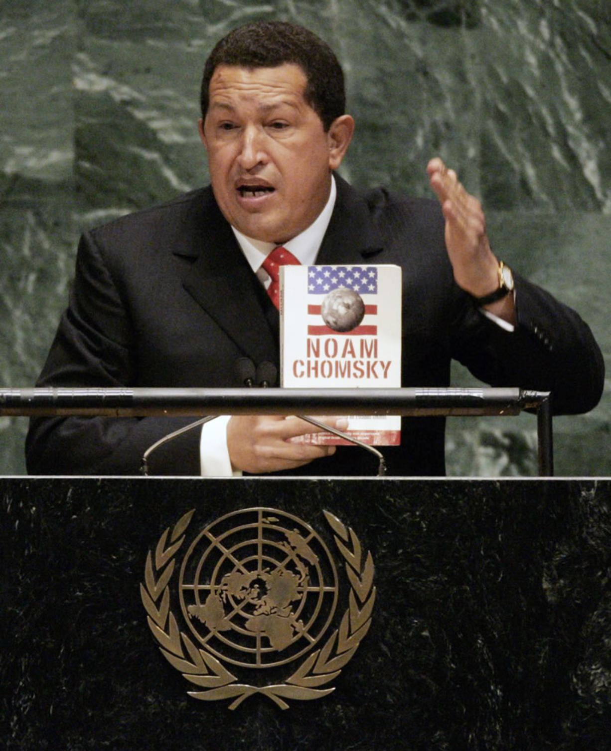
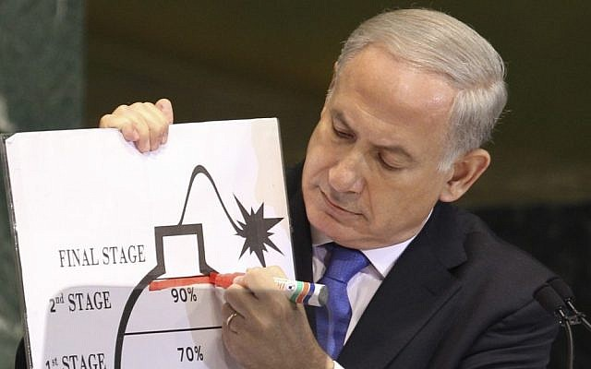
The UN General Debate

Slide 4
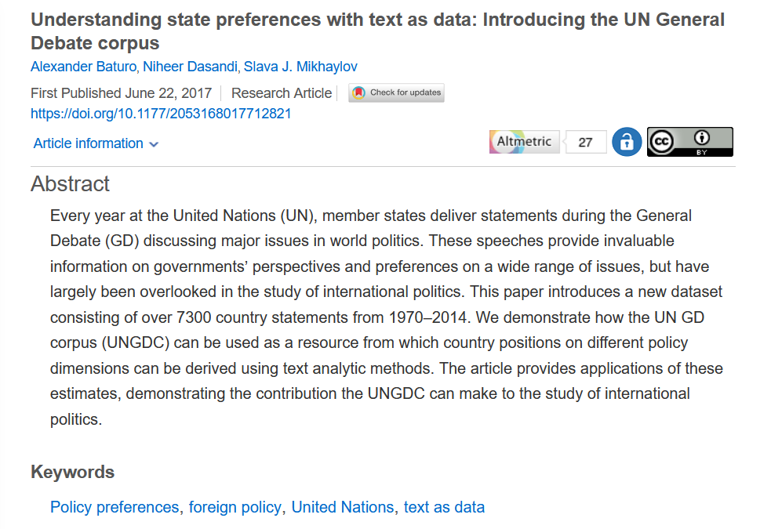
The Data

Slide 5
The Data
Digital version of texts obtained from running (occasionally imperfect) OCR on hard copies
Texts originally translated into English by the UN Secretariat
Did pretty standard text pre-processing on the raw text files via SpaCy (removed page numbers, tokenization, lemmatization, etc.)

Slide 6
The Data
Descriptive Stats:
Number of years in the corpus: 49
Number of countries in the corpus: 200
Number of documents in the corpus: 8,093
Number of words in the corpus: approx. 22.6 million
Average number of words per document: 2,794
Number of unique lemmas in the corpus: 73,915

Slide 7
Three Applications
Topic Tracing over Time
Topic Tracing at the Country Level
Semantic Similarity Analysis

Slide 8
Application 1: Topic Tracing
Question: How have the topics discussed at the UNGD evolved over time?

Slide 9
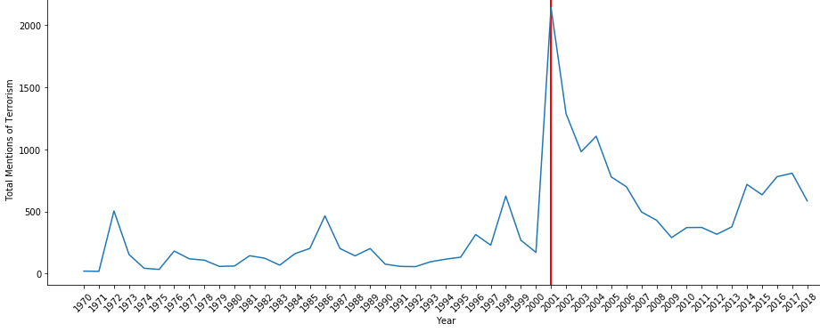
Mentions of Terrorism at the UNGD over Time
9/11

Slide 10
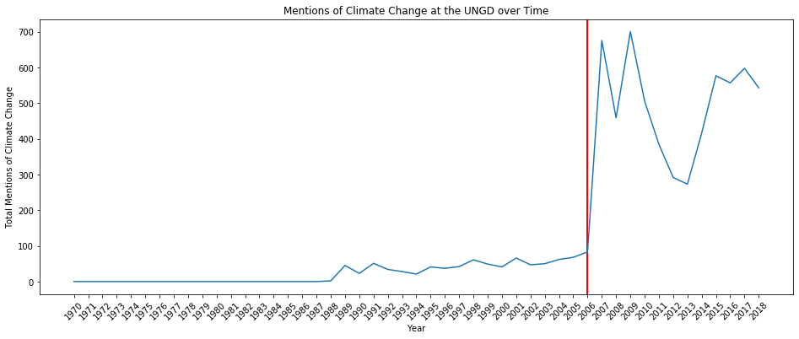
Mentions of Climate Change at the UNGD over Time
Al Gore’s
An Inconvenient Truth

Slide 11
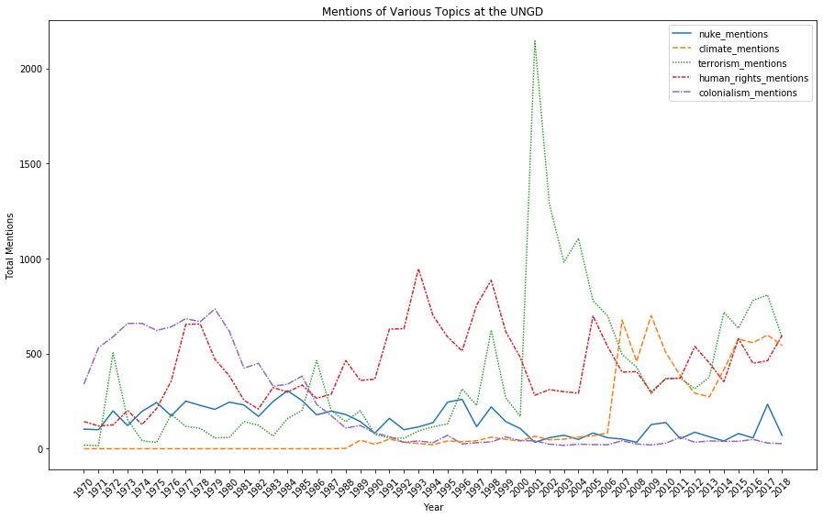
Mentions of Various Topics at the UNGD

Slide 12
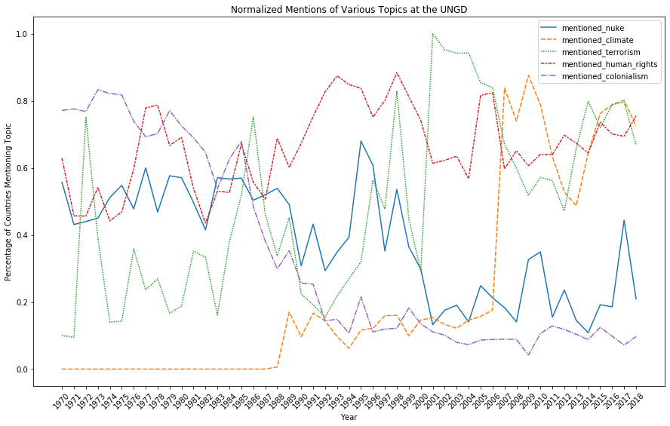
Mentions of Various Topics at the UNGD (normalized)

Slide 13
Application 2:
Topic Tracing at the Country Level
Question: Which countries over-mention terrorism? Which countries under-mention terrorism?

Slide 14
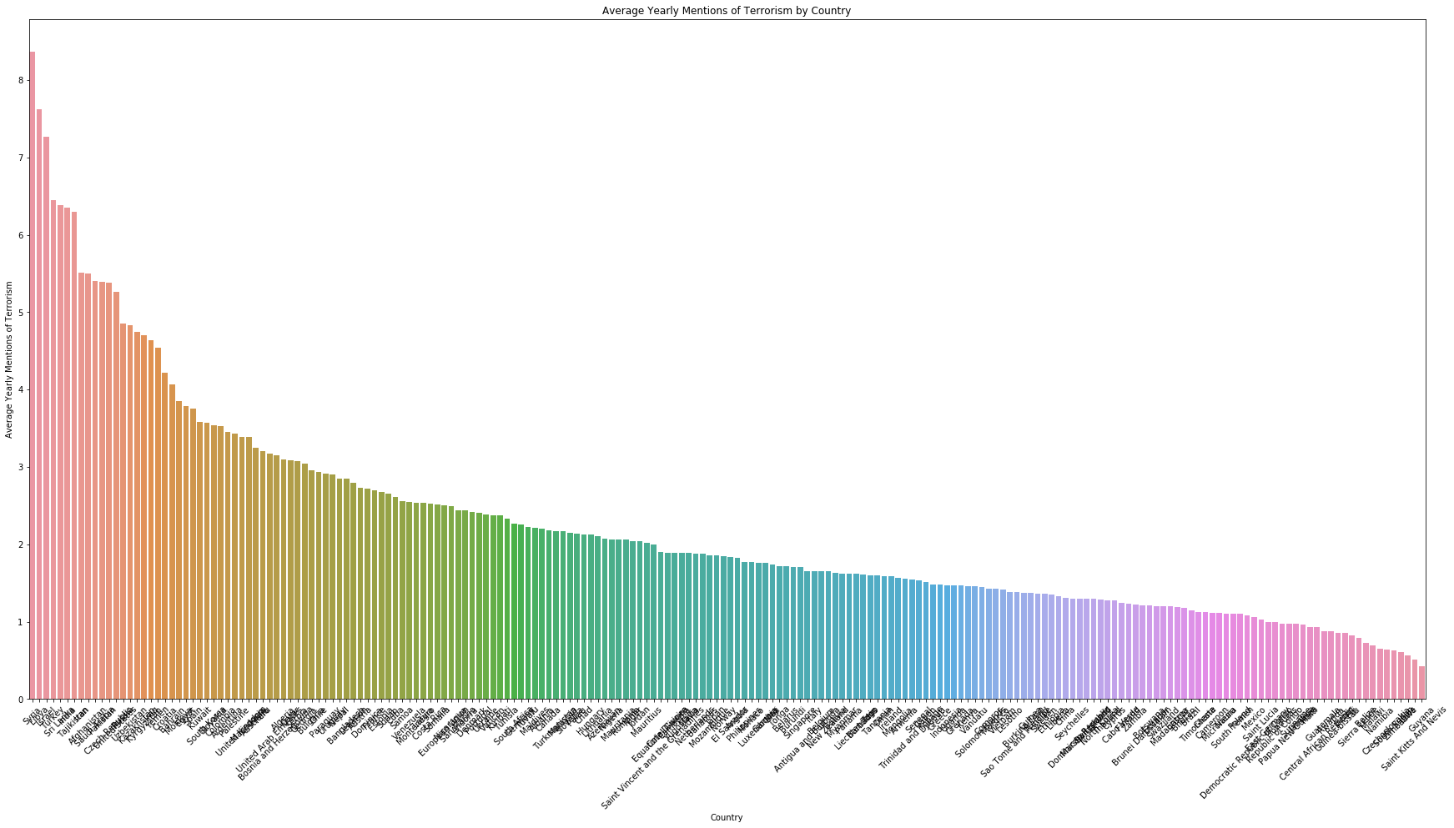
Average Yearly Mentions of Terrorism by Country

Slide 15
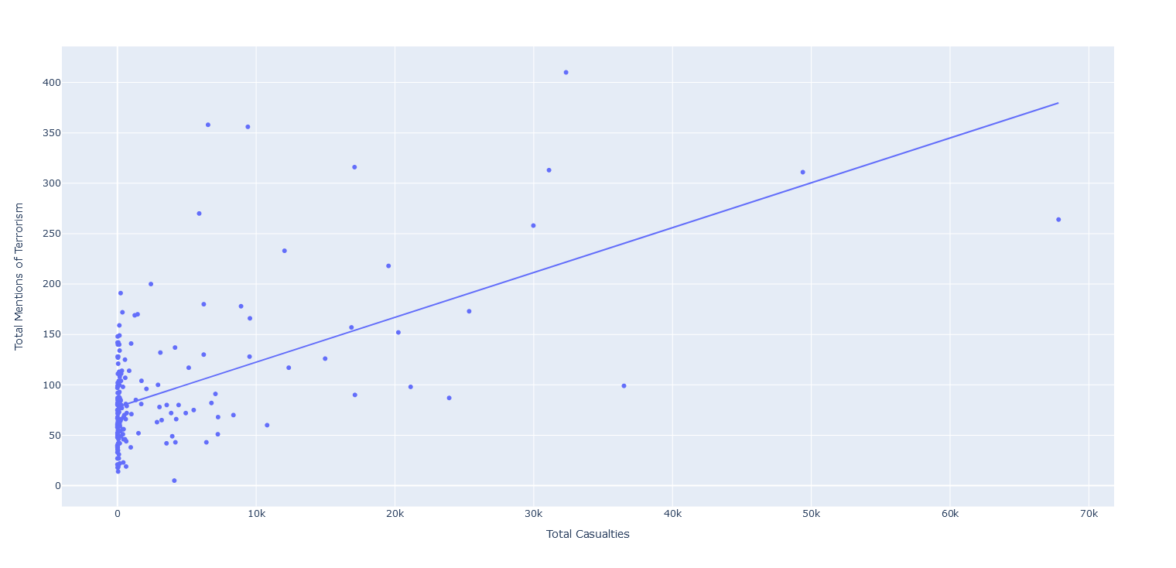
Terrorism Casualties vs. Terrorism Mentions by Country

Slide 16
Application 3:
Semantic Similarity Analysis
Question: Is Russia more of a “European” country or an “Asian” country?

Slide 17
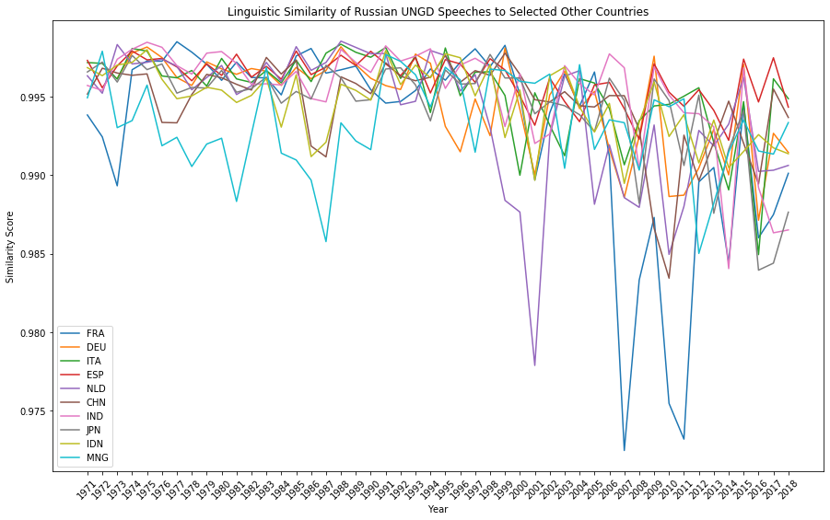
Semantic Similarity of Russian UNGD Speeches to Selected Other Countries
More Similar
Less Similar

Slide 18
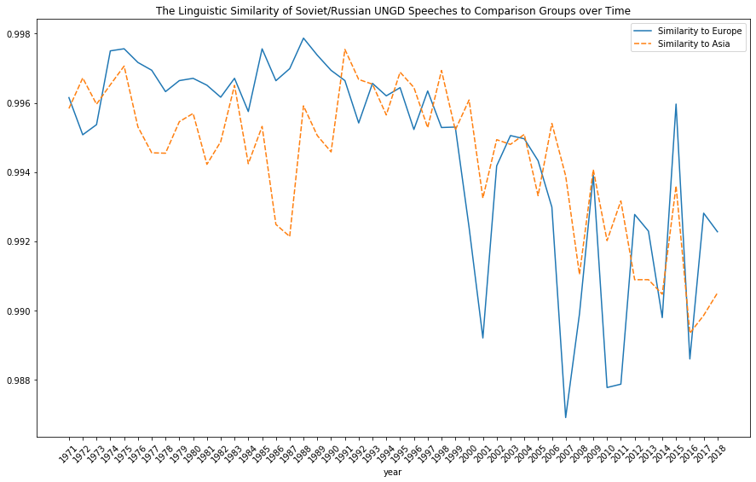
Semantic Similarity of Russian UNGD Speeches to Comparison Groups over Time
More Similar
Less Similar

Slide 19
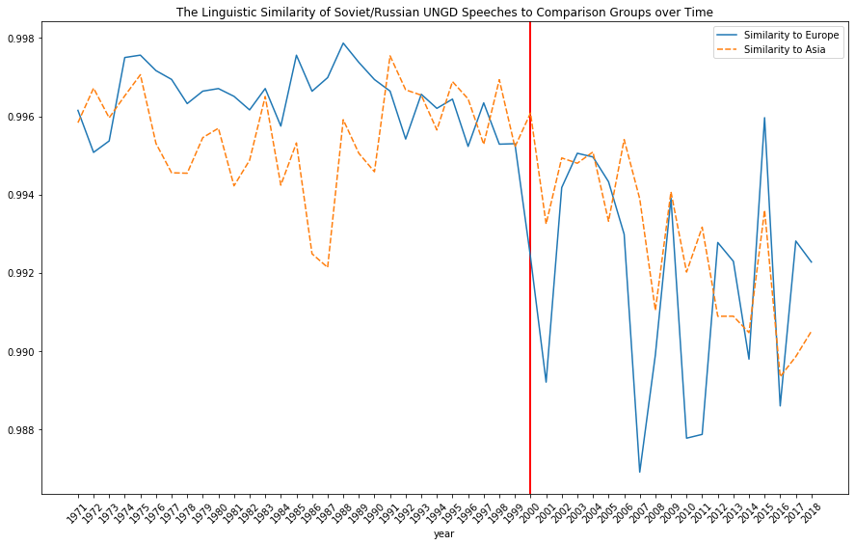
Semantic Similarity of Russian UNGD Speeches to Comparison Groups over Time
More Similar
2000
Putin comes to power
Less Similar

Slide 20
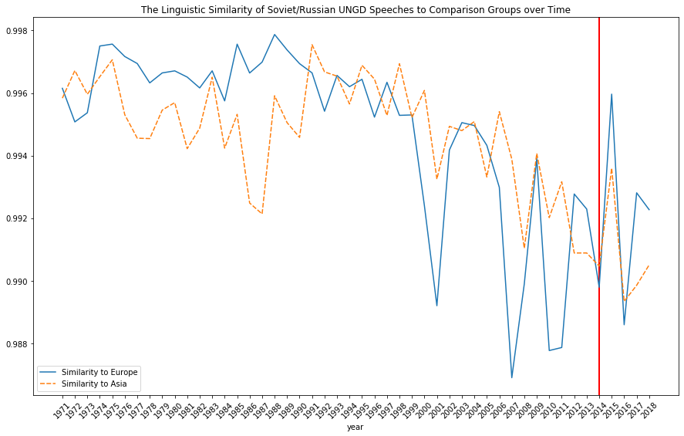
Semantic Similarity of Russian UNGD Speeches to Comparison Groups over Time
2014
Russia annexes Crimea
More Similar
Less Similar

Slide 21
Possible Takeaways

Slide 22
Countries are super reactive and influenced by their peers
e.g. everyone reacting to 9/11, climate change
Speeches at the UNGD have a performative aspect
e.g. Putin changing Russian discourses, countries defending themselves from charges of terrorism

Slide 23
Directions for Future Research

Slide 24
Simple network analysis (which countries mention other countries at the UNGD)?
Finding additional datasets to combine with the topic tracing for deeper insights (e.g. climate change vulnerability data)

Slide 25
Questions?
THANK YOU

Slide 26
Acknowledgments
Python Packages Used:
Core Packages
import spacy
from spacy import displacy
from spacy.matcher import Matcher
from spacy.matcher import PhraseMatcher
import en_core_web_lg
Other Key Packages
import numpy as np # Used to structure data
import pandas as pd # Used to structure data
import seaborn as sns # Used to visualize data
import plotly.express as px # Used to visualize data
import matplotlib.pyplot as plt # Used to visualize data
Special thanks to Leo K. and Zita Z. for assistance and troubleshooting!

Slide 27
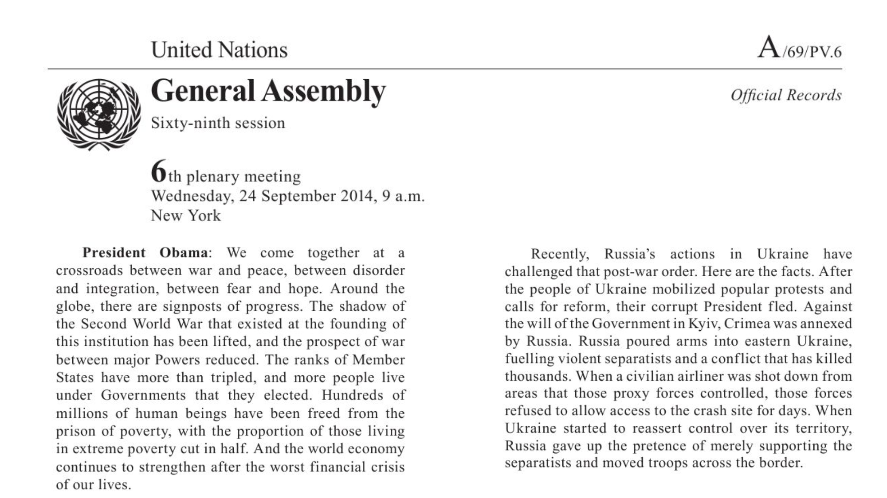
Appendices

Slide 28
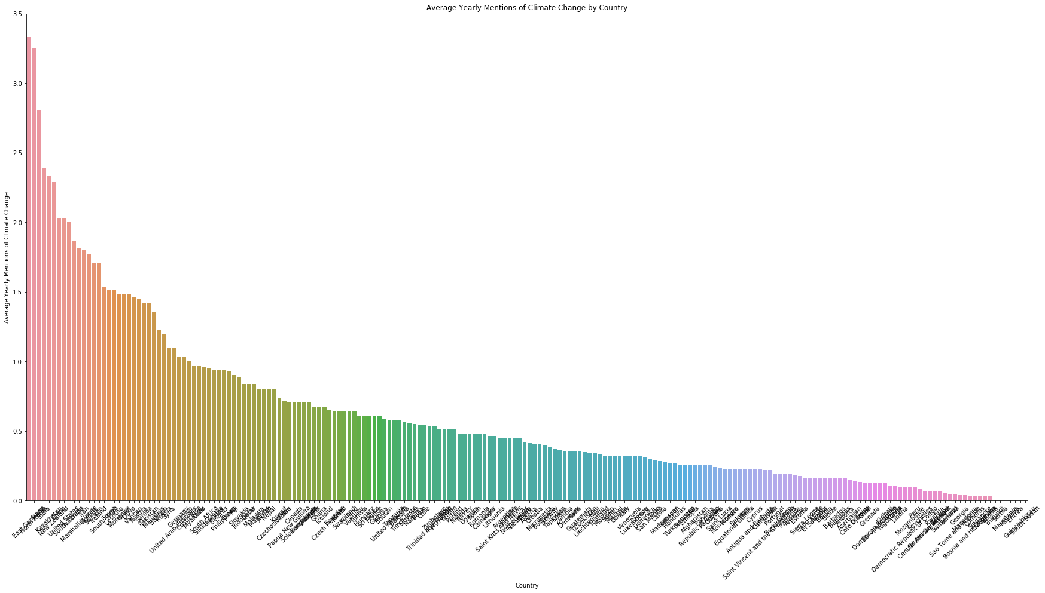
Average Yearly Mentions of Climate Change by Country

